Slide 1
Building Trust In The Supply Chain Since 2016

Slide 2

Our Mental Model Of The Supply Chain

Slide 3

The Actual Supply Chain

Slide 4
67.4%
of managers monitor their supply chain with Excel spreadsheets
https://www.zippia.com/advice/supply-chain-statistics/

Slide 5
62%
of additional cost with supply chain disruptions
https://www.zippia.com/advice/supply-chain-statistics/

Slide 6
94%
of companies do not have full visibility of their supply chain
https://www.zippia.com/advice/supply-chain-statistics/

Slide 7
This Is Weird

Slide 8
57%
of companies see supply chain management as a competitive edge
https://www.zippia.com/advice/supply-chain-statistics/

Slide 9
70%
of companies see supply chains as a driver for customer service
https://www.zippia.com/advice/supply-chain-statistics/

Slide 10
40%
savings available for industrial suppliers via optimization
https://www.zippia.com/advice/supply-chain-statistics/

Slide 11
Conclusion: Talking != Doing

Slide 12
As Usual, Open Source Is Not Special

Slide 13
> 90%
of codebases using open source
https://www.synopsys.com/blogs/software-security/open-source-trends-ossra-report/

Slide 14
81%
of codebases have security vulnerabilities
https://www.synopsys.com/blogs/software-security/open-source-trends-ossra-report/

Slide 15
53%
of codebases contain license compliance issues
https://www.synopsys.com/blogs/software-security/open-source-trends-ossra-report/

Slide 16
Don’t Panic, We Are Doing Something About It

Slide 17


“We” = Large Community Lead By:

Slide 18
The Secret: Good Processes = Good Supply Chain
Know what you are doing
Know how you are doing it
Use records to make it repeatable
Have a plan to fix problems

Slide 19
Trust Built By Process Management
OpenChain ISO/IEC 5230:2020 is the International Standard for open source license compliance. It is simple, effective and suitable for companies of all sizes in all markets. This standard is openly developed by a vibrant user community and freely available to all. It is supported by free online self-certification, extensive reference material and official service provider partners.
The OpenChain Security Assurance Specification is the de facto standard for open source security compliance. It is simple, effective and suitable for companies of all sizes in all markets. This standard is openly developed by a vibrant user community and freely available to all. A growing ecosystem of material is forming to support it.

Slide 20
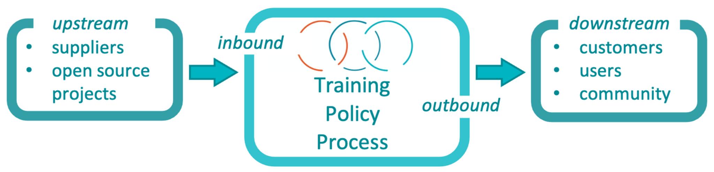
Our Standards Work Company By Company
Notes:
The OpenChain standards define the big picture, showing the inflection points where a company should have processes, policies or training.

Slide 21
They Result In A More Predictable Supply Chain
Notes:
Taken in aggregate the adoption of OpenChain standards by companies in a supply chain dramatically reduces the chance of errors in individual companies, dramatically increases the predictability of how other companies in the supply chain address compliance, and dramatically reduces the time to isolate and remediate process errors or failings. Everyone is asking and answering the same questions.

Slide 22
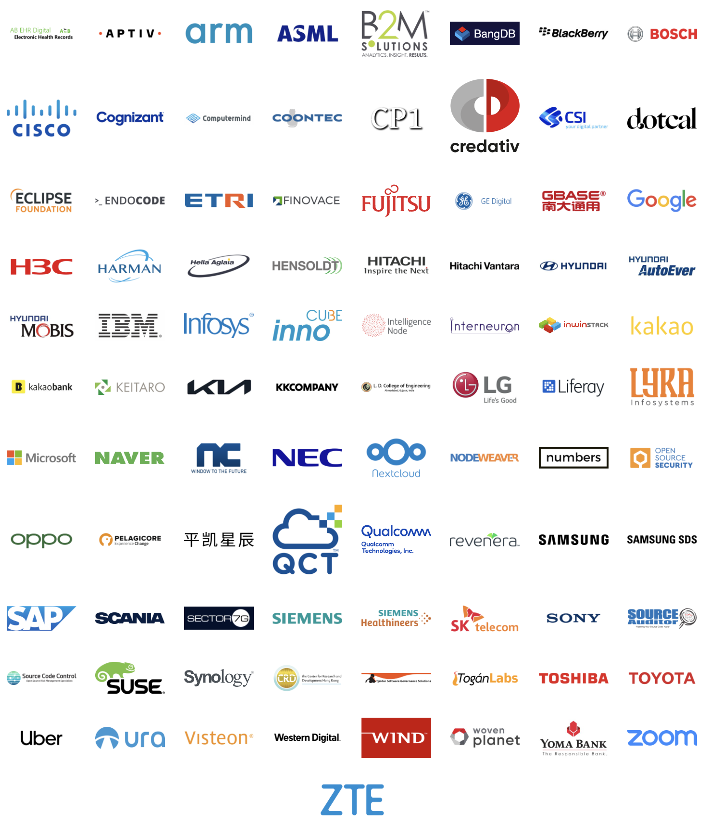
Example Adoption Announcements Of OpenChain ISO/IEC 5230:2020 On The OpenChain Website
Notes:
The total market adoption is far larger. For example, a PwC-sponsored survey by Bitkom showed 20% of German companies with 2,000 or more employees were already using ISO 5230

Slide 23
20%
of German companies with over 2,000 employees already use OpenChain ISO/IEC 5230
https://www.pwc.de/en/digitale-transformation/pwc-bitkom-study-open-source-monitor-2021.pdf

Slide 24


Recent Security Assurance Specification Adoption

Slide 25
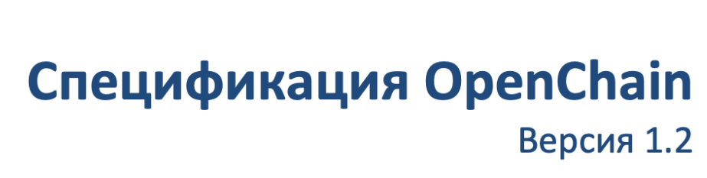
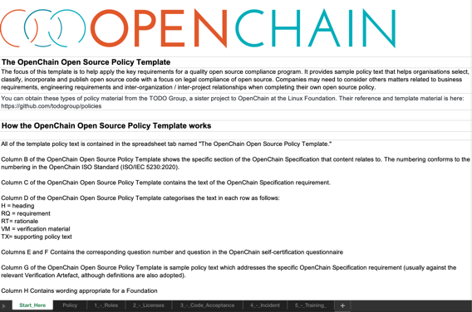
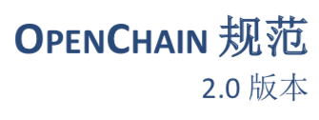
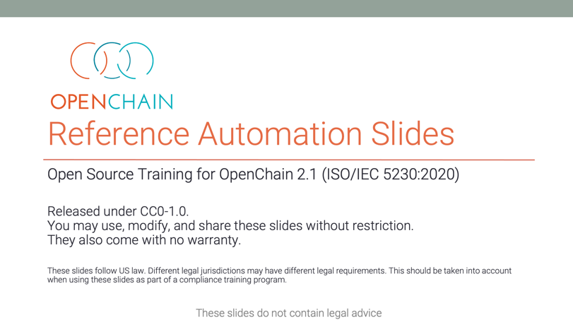

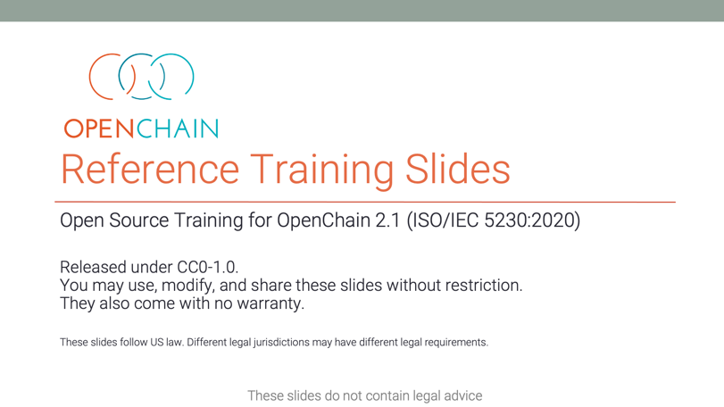
We Provide Extensive Reference Material
Notes:
We provide a wide range of reference materials and translations.

Slide 26
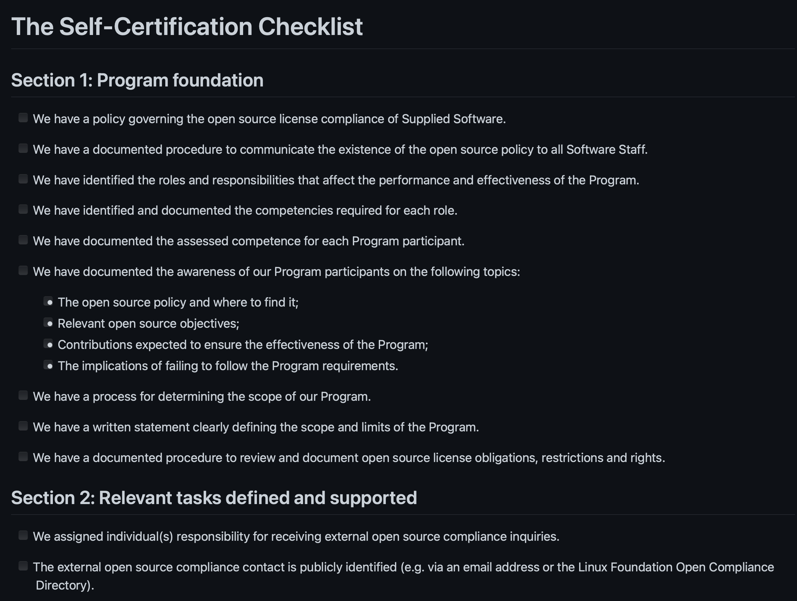
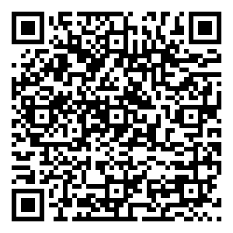
Including Free Self-Certification Material
Notes:
We provide a wide range of reference materials and translations.

Slide 27
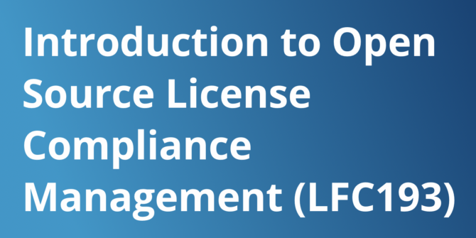
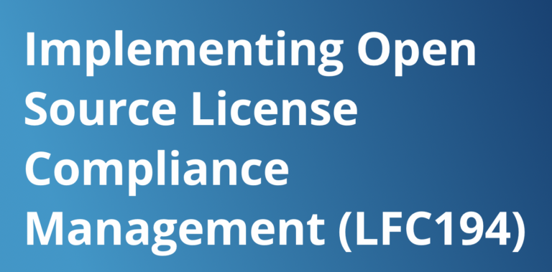

We Make Free Online Training Courses
LFC193 - 1209 total enrollments (398 digital badges issued) 4.65 out of 5 rating by users
LFC194 - 579 total enrollments (138 digital badges issued) 4.55 out of 5 rating by users
Notes:
We work with LF Training to help make education easier around open source process management.

Slide 28
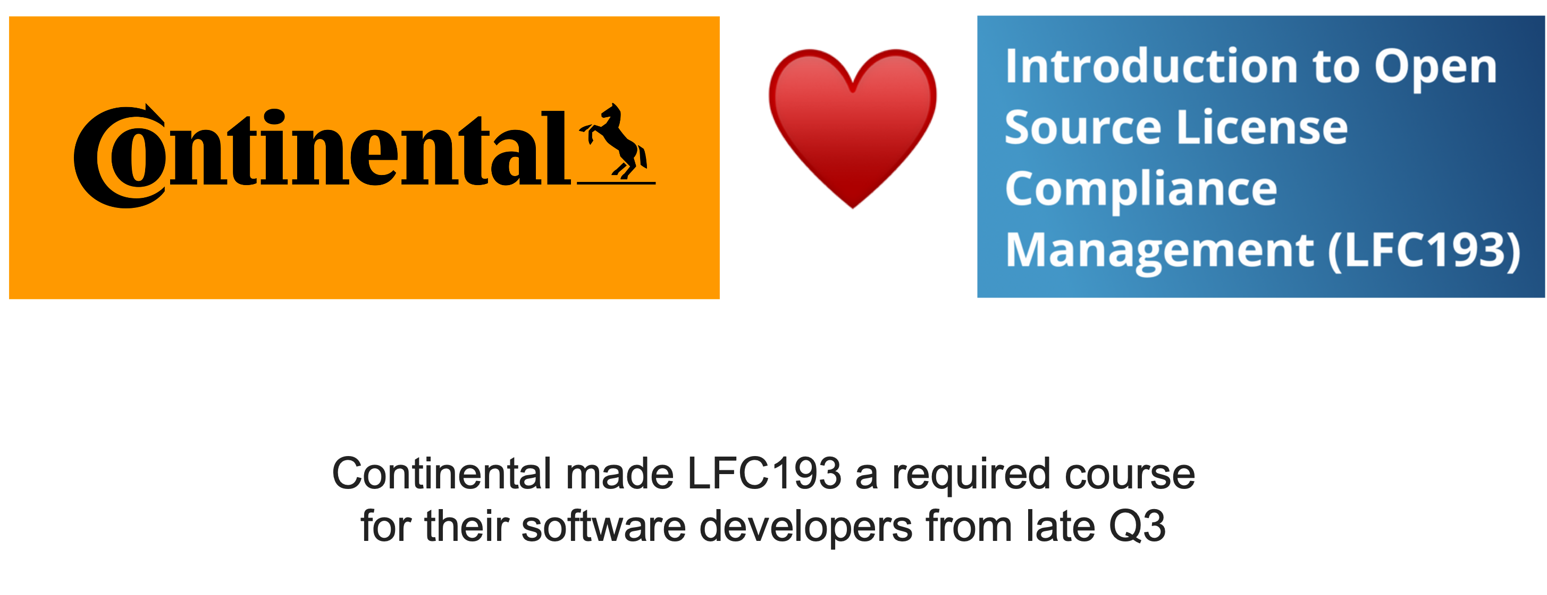
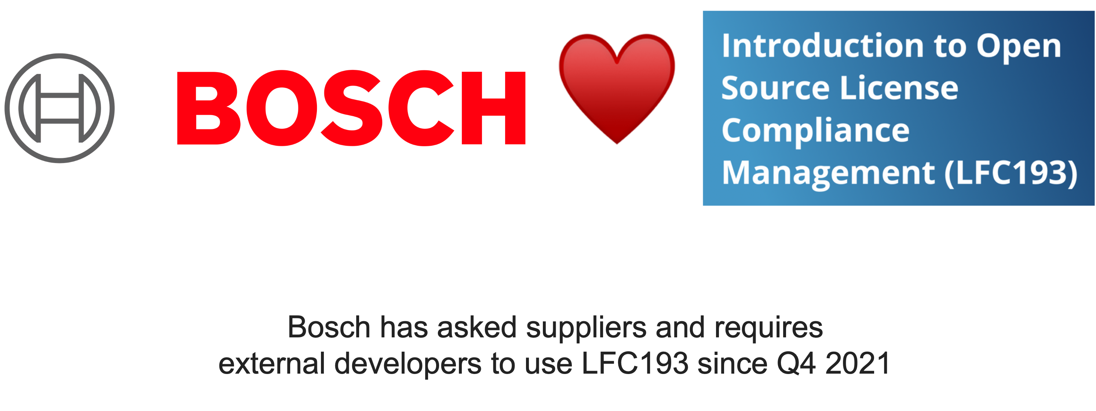
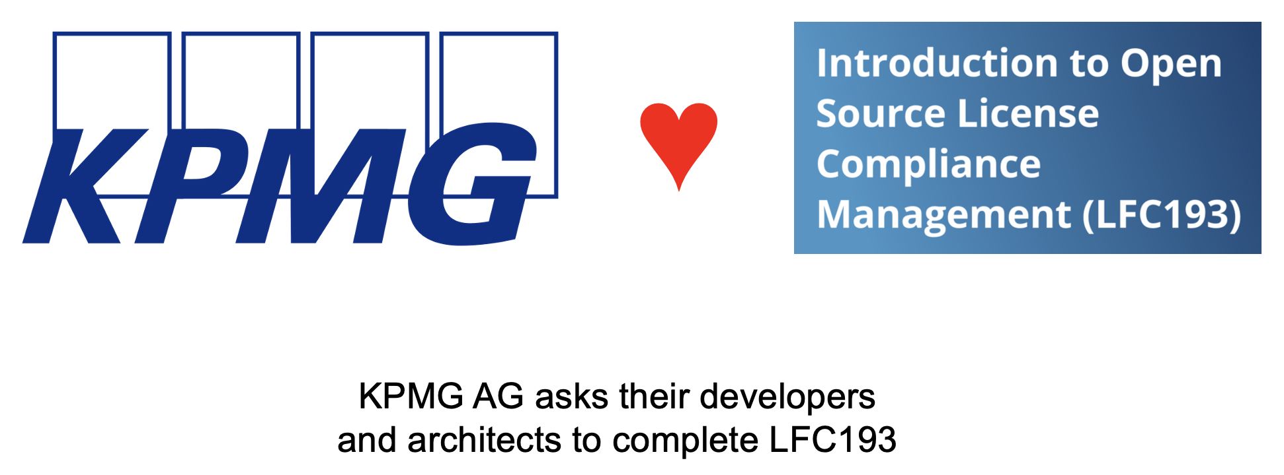
Example Of Market Use
Notes:
These resources make a real difference to companies

Slide 29

Example Of Market Use
♥️
Continental made LFC193 a required course for their software developers from late Q3
Notes:
These resources make a real difference to companies

Slide 30

Example Of Market Use
♥️
Bosch has asked suppliers and requires external developers to use LFC193 since Q4 2021
Notes:
These resources make a real difference to companies

Slide 31

Example Of Market Use
♥️
KPMG AG asks their developers and architects to complete LFC193
Notes:
These resources make a real difference to companies

Slide 32
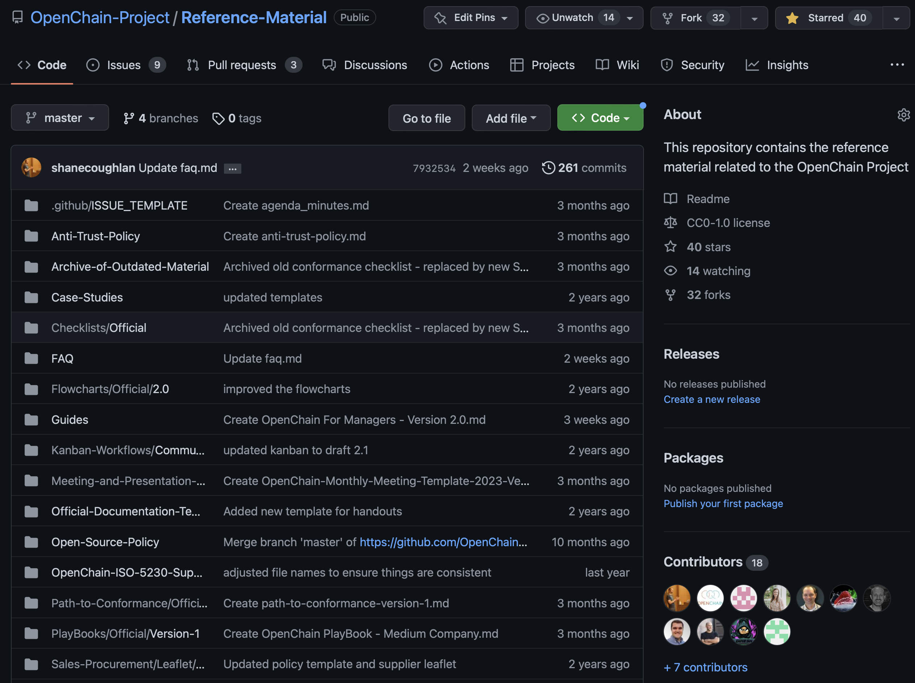
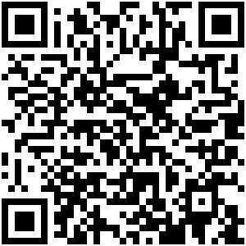
There Are Over 1,000 Documents In Our Library
Notes:
There are over 1,000 documents in our reference library

Slide 33
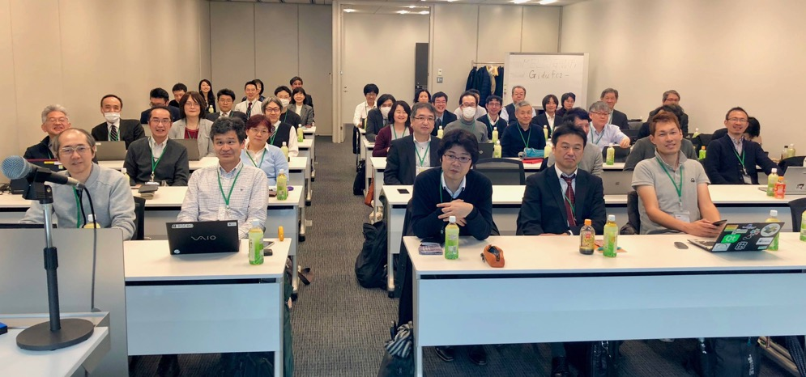
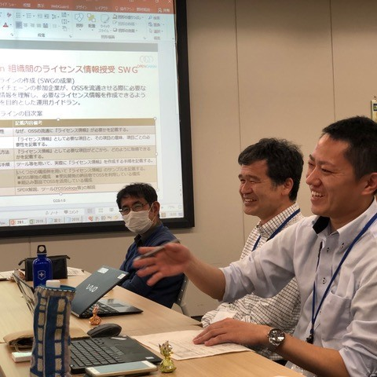
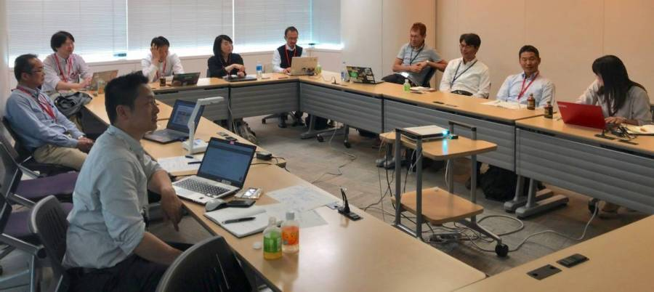
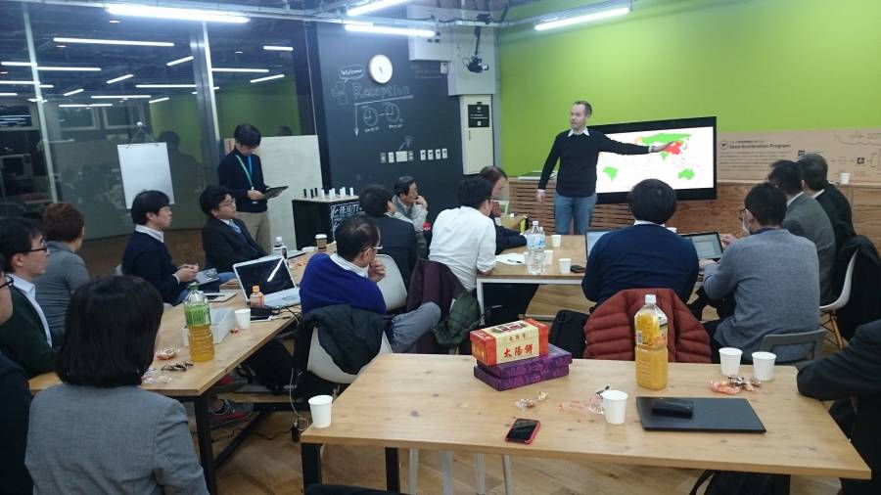
We Put The User Company Community First
Notes:
A great example of the global OpenChain community can be found in Japan. This is our most active country-based work team, with bi-monthly meetings, and with 7 sub-groups currently working on specific items like supplier education and tooling automation.

Slide 34
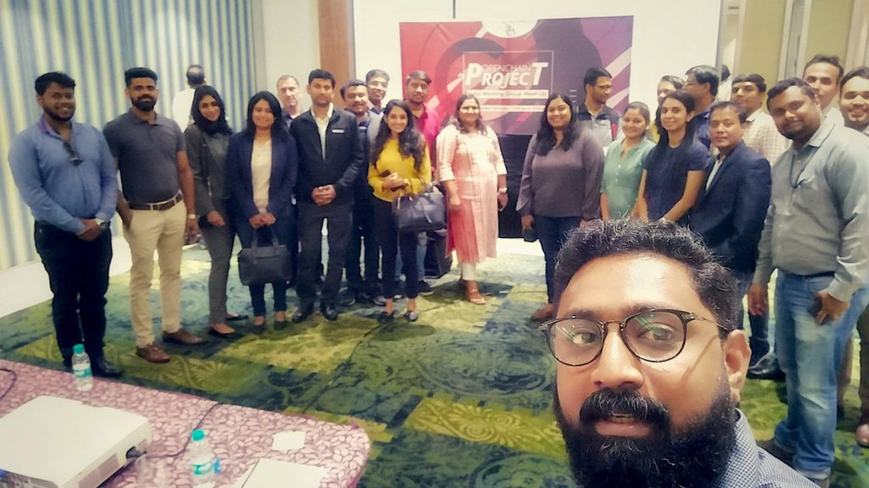

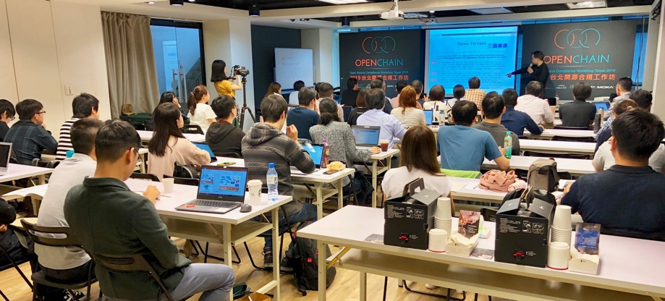
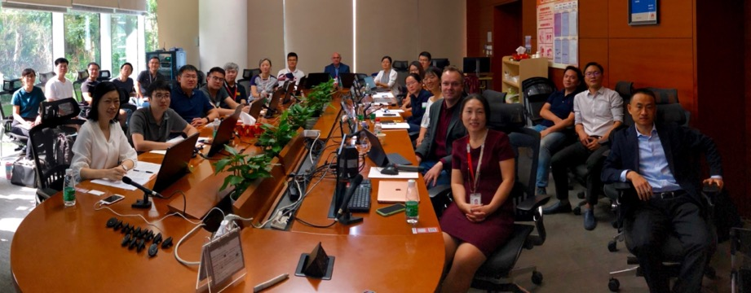
Everywhere And Always!
Notes:
We have active local work groups in China, Korea, India and Taiwan, as well as in Europe and the USA.

Slide 35

Work Groups And Special Interest Groups
Main Official:
Specification Work Group (Spring 2016~)
Education Work Group (Autumn 2020~)
Community Created:
Tooling Work Group (Summer 2019~)
Export Control Work Group (Winter 2022~)
Public Policy Work Group (Winter 2022~)
Specific Industry Focus:
Automotive Special Interest Group (Summer 2019~)
Telecom Special Interest Group p (Spring 2021~)
Notes:
Here are some examples of our global work groups and when they started.

Slide 36
Regional User Groups
OpenChain in Japan (Dec 2017~)
OpenChain in Korea (Jan 2019~)
OpenChain in India (Sept 2019~)
OpenChain in China (Sept 2019~)
OpenChain in Taiwan (Sept 2019~)
OpenChain in Germany (Jan 2020~)
OpenChain in the UK (June 2020~)
OpenChain in the USA (Dec 2020~)
Notes:
Here are some examples of our regional work groups and when they started.

Slide 37
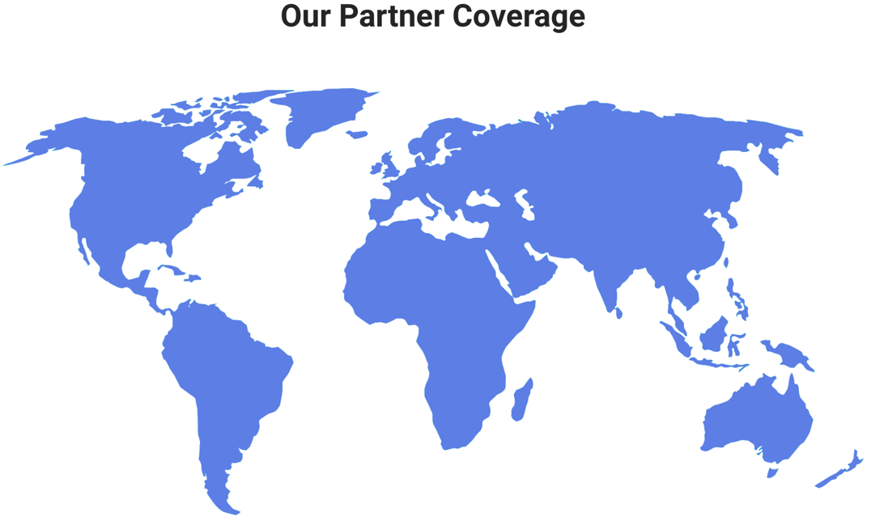
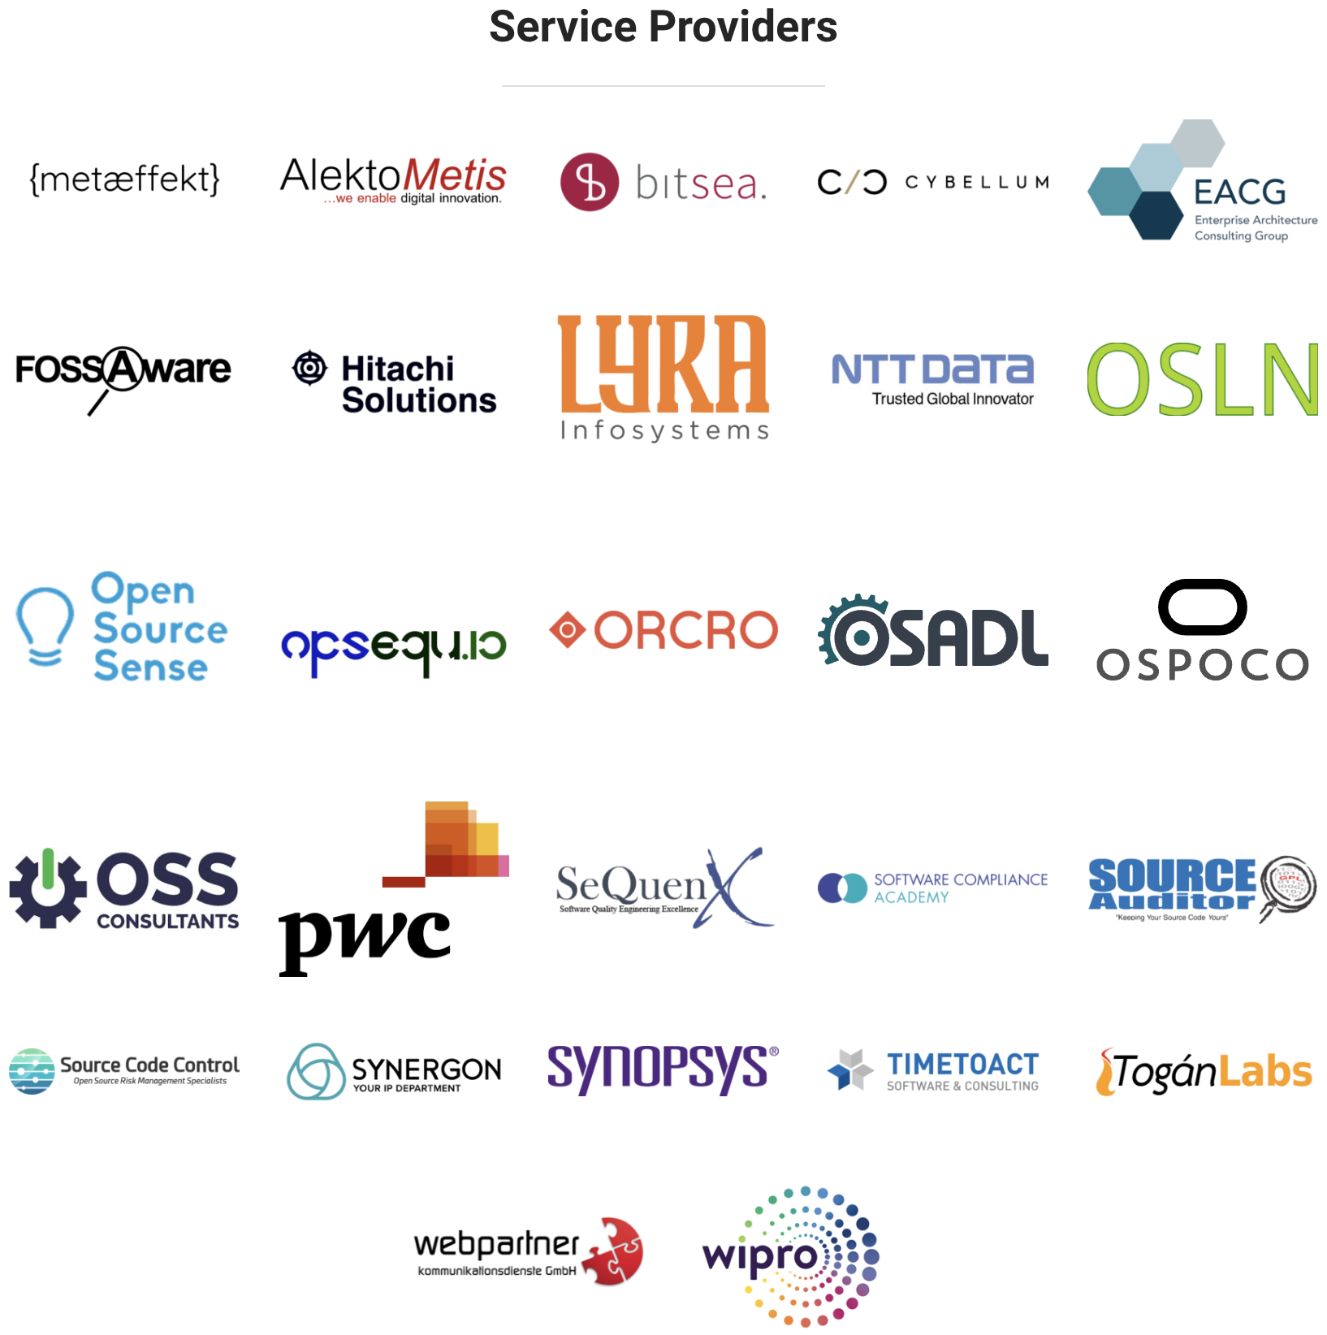
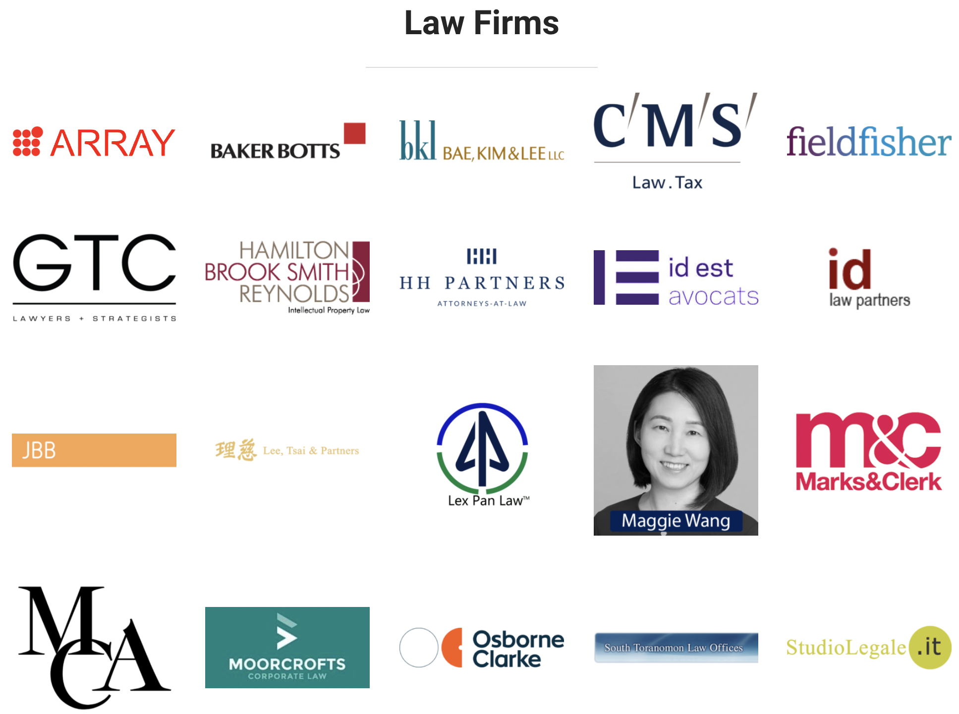

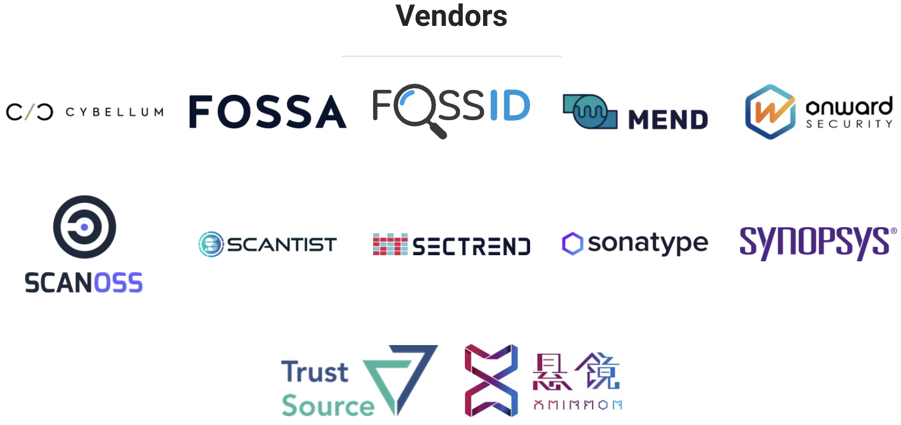
Official Partner Program
Notes:
We have substantial and growing geographic coverage for the partner program. It now covers a significant number of strategic geographic locations, including the United States, China, South Korea, India, Japan, the UK, Germany, Italy, Spain, Sweden and Ireland.

Slide 38

10 Third-Party Certifiers Providing Global Coverage
Notes:
We have a growing number of global third party certifiers available.

Slide 39

Freedom Of Choice In Adopting Our Standards
Self-Certification
Independent Compliance Assessment
Third-Party Certification
Notes:
When it comes to meeting the OpenChain industry standard for open source compliance, we are fostering a diverse series of options for our diverse range of stakeholders, from self-certification to independent compliance assessments to third party certification. For example, a company can use our free online questionnaire to self-certify without cost. Or they can hire a third party certifier to have outside confirmation of processes. It is up to the company and the market.

Slide 40
OpenChain is run by user companies for user companies

Slide 41
We Make The Open Source Supply Chain More Efficient

Slide 42

Be Part Of This
https://www.openchainproject.org/participate

